Slide 1

Sprocket Central Pty Ltd
Data analytics approach
Gloria Sara Joji

Slide 2
Agenda
Introduction
Data Exploration
Model Development
Interpretation

Slide 3
Introduction
Identify and Recommend Top 1000 Customers to Target from Datasets
Outline of the problem
Sprocket Central is a company that specializes in high-quality bikes and cycling accessories.
Their marketing team is looking to boost business sales by analyzing provided datasets.
Using the 3 datasets provided 1000 customers that Sprocket Central should target to drive higher value for the company.

Slide 4
Introduction
Contents of Data Analysis
Bike related purchases over the last 3 years by gender
Job industry distributions
Number of cars owned and not owned by the state
RFM analysis and customer distribution
This will be done with the three phases : Data Exploration, Model Development and Interpolation.

Slide 5
Data Exploration
Data Quality Assessment and ‘Clean Up’
Key Issues for Data Quality Assessment
Accuracy: Correct Values
Completeness: Data Fields with Values
Consistency: Values Free from Contradiction
Currency: Values up to Date
Relevancy: Data items with Value Meta-data
Validity: Data Containing Allowable Values
Uniqueness: Records that are Duplicated
An in-depth analysis has been sent via email.
Summary Table
 | Accuracy | Completeness | Consistency | Currency | Relevancy | Validity
Customer Demographic | DOB: inaccurate Age: missing | Job title: blanks Customer id: incomplete | Gender: inconsistency | Deceased customers: filter out | Default column: delete
Customer Address |  | Customer id: incomplete | States: inconsistency
Transactions | Profit: missing | Customer id: incomplete Online order: blanks Brand: blanks |  |  | Cancelled status order: filter out | List price: Product sold Date: format

Slide 6
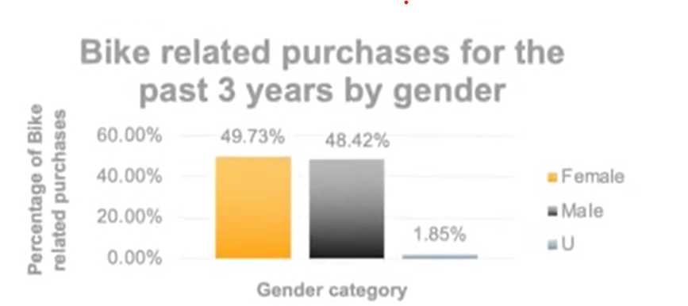
Data Exploration
Bike related purchases over last 3 years by gender
Over the last three years about 50% of bike related purchases made by females to 48% of purchases made by males. Approximately 2% were made by unknown gender
Numerically, females purchases almost 10000 more than males
Females make up majority of bike related sales

Slide 7
Data Exploration
Job Industry Distribution
20% of ‘New Customers are in Manufacturing and Financial Services.
The smallest number of customers are in Agriculture and Telecommunication at 3%
Similar pattern in ‘Old customer list at 20% and 19% in Manufacturing and Financial Services respectively.

Slide 8
Data Exploration
Number of cars owned and not owned by state
NSW has the largest amount of people that do not own a car. NSW seems to have a higher number of people from which data was collected.
Victoria is also a split quite evenly. But both numbers are significantly lower than those pf NSW
QLD has a relatively high number of customers that own a car.

Slide 9
Model Development
RFM Analysis and Customer Classification
RFM analysis is used to determine which customer a business should target to increase its revenue and value.
The RFM( Recency, Frequency and Monetary) model shows customers that have displayed high levels of engagement with the business in the three categories mentioned.

Slide 10
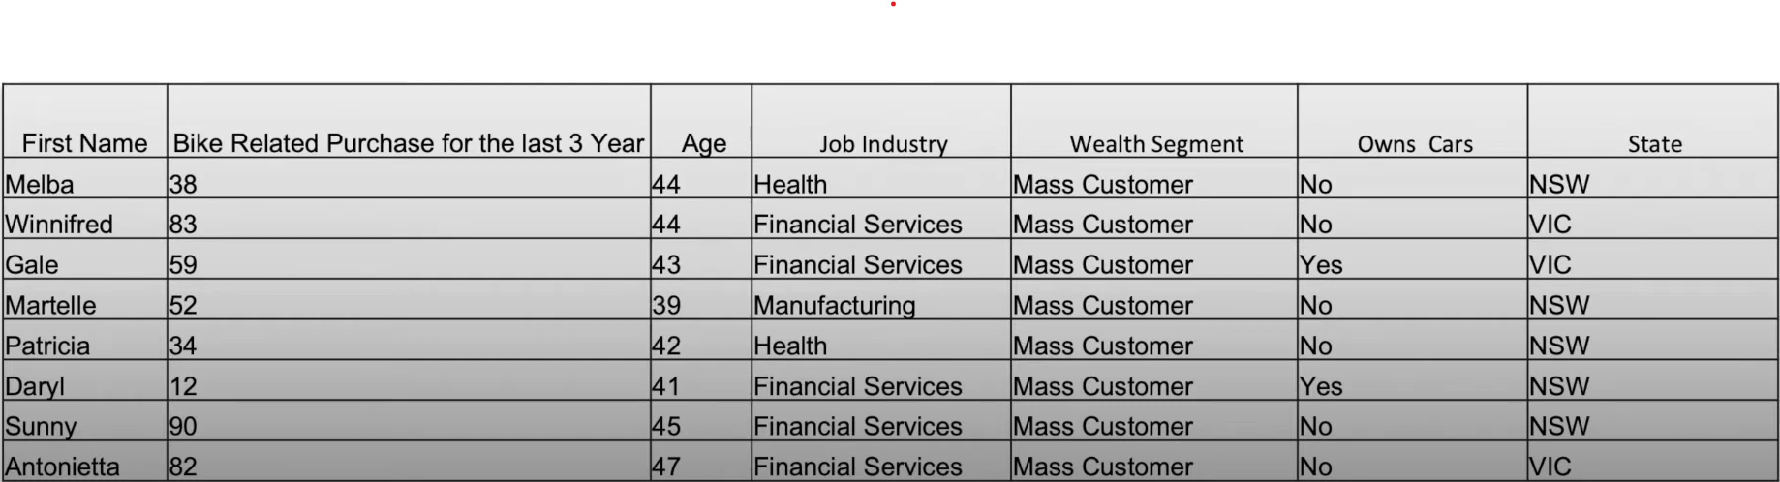
Interpretation
Summary Table for High Value Customers
Here is a snapshot of a few customers that will come under the high value customer classification..

Slide 11
Appendix

